Slide 1
CAR CRASH DETECTION USING (CONVOLUTIONAL NEURAL NETWORKS)CNN
PRESENTED BY: SANTHOSH S
REGISTER NO:211521104142
DEPARTMENT:COMPUTER SCIENCE AND ENGINEERING

Slide 2
PROJECT TITLE
CAR CRASH DETECTION USING (CONVOLUTIONAL NEURAL NETWORKS)CNN

Slide 3


AGENDA
End Users
Our Solution and Proposition
Project Overview
Key Features
Modelling Approach
Results and Evaluation
Conclusion
Problem Statement
3/21/2024 Annual Review

Slide 4
PROJECT GOALS
Design and develop a car crash detection system using (chosen approach).
Achieve high accuracy in differentiating between crash and non-crash scenarios.
(Optional, if applicable) Enable real-time crash detection for immediate response.
(Optional, if applicable) Integrate the system with existing infrastructure or communication channels for automated emergency response initiation.
A functional car crash detection system prototype.
Evaluation of the system's accuracy and performance.
(Optional) Documentation outlining system design, implementation details, and future enhancements.

Slide 5

PROBLEM STATEMENT
Growing concern over road accidents
Need for advanced systems to detect and respond to crashes swiftly
Lack of efficient methods to alert emergency services promptlyRoad traffic accidents are a leading cause of death and injury worldwide. Early detection and response to these events are crucial for minimizing casualties and property damage.
This project aims to develop a robust car crash detection system using Convolutional Neural Networks (CNNs). The system will analyze traffic scenes (images or video frames) and automatically identify whether a car crash is occurring.

Slide 6

PROJECT OVERVIEW
This project aims to develop a system that automatically detects car crashes. This can be achieved through various approaches, with this project focusing on (specify your chosen approach - e.g., sensor-based, vision-based using cameras).
Project Goals:
Design and develop a car crash detection system using (chosen approach).
Achieve high accuracy in differentiating between crash and non-crash scenarios.
(Optional, if applicable) Enable real-time crash detection for immediate response.
(Optional, if applicable) Integrate the system with existing infrastructure or communication channels for automated emergency response initiation.

Slide 7

WHO ARE THE END USERS?
Individual Drivers: In-vehicle car crash detection systems with emergency response initiation can directly benefit individual drivers. If a crash is detected and the driver is incapacitated, the system can automatically call emergency services, potentially saving lives and reducing response times.
Insurance Companies: Car crash detection data can be valuable for insurance companies in risk assessment, accident investigation, and potentially offering usage-based insurance plans with discounts for safe driving habits.

Slide 8

OUR SOLUTION AND ITS VALUE PROPOSITION
Introducing our Car Crash Detection System
Leveraging advanced sensors and AI algorithms
Swift detection and notification of accidents
Seamless integration with emergency services
Focus on the unique advantages your proportion offers. Is it highly accurate? Does it work well in diverse crash scenarios? Does it require less computational power compared to other methods?
By addressing these points, you can effectively communicate the value proposition of your car crash detection solution.
Here's an additional suggestion: Consider conducting a pilot study or simulation to test your proportion-based approach against existing methods.

Slide 9

THE "WOW" IN OUR SOLUTION
Real-time Updates: Continuous monitoring and updating during matches.
Predictive Analytics: Accurate predictions based on various factors.
Interactive Interface: User-friendly dashboard for easy access.
Customization: Tailored features for different user preferences.
Performance Metrics: Evaluation based on accuracy, precision, and recall.
Swifter Emergency Response: Faster notification of accidents allows emergency services to reach victims quicker, potentially saving lives and reducing injuries.
Enhanced Driver Assistance Systems (ADAS): Integration with ADAS can warn drivers of impending collisions, enabling them to take preventive measures and avoid accidents altogether.
3/21/2024 Annual Review
9

Slide 10
MODELLING
Data Acquisition: (Specify data collection method based on chosen approach - e.g., in-vehicle sensors for sensor-based system, traffic cameras or dashcams for vision-based system).
Data Preprocessing: Cleaning and preparing the collected data for the chosen detection method (e.g., sensor data calibration, image/video frame annotation for vision system).
Crash Detection Algorithm: (Specify chosen approach - e.g., developing algorithms to analyze sensor data for sudden changes indicative of a crash, training a machine learning model on labeled data for vision system).
(Optional) Communication Module: Enabling real-time data transmission or sending alerts to emergency services (if applicable).
10

Slide 11
Training and Validation:
Cross-validation techniques.
Hyperparameter tuning.
Deployment:
API integration for real-time predictions.
Cloud-based hosting for scalability

Slide 12
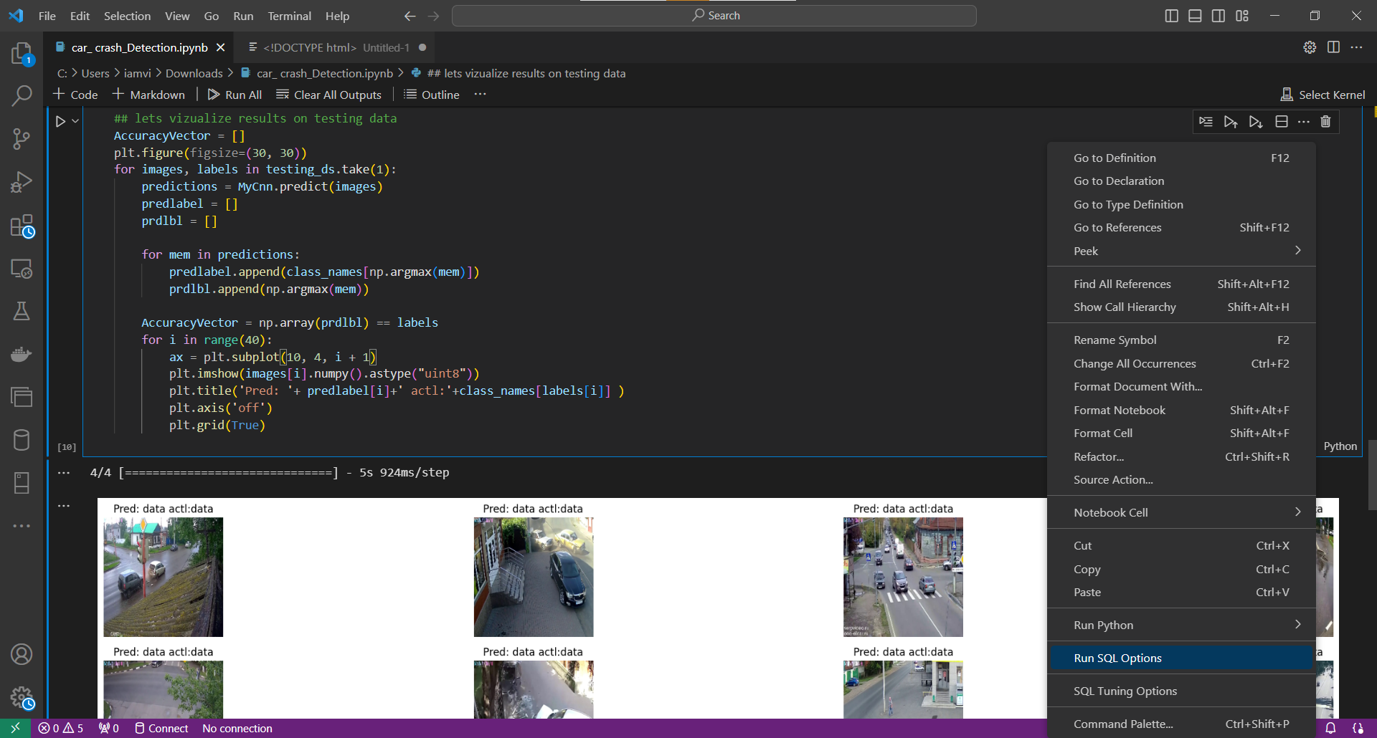
RESULT
12

Slide 13
Evaluation:
Performance Metrics:
Accuracy: X%
Precision: X%
Recall: X%
Comparison with Baseline:
Improvement in accuracy by X%.
User Feedback:
Positive responses from beta testers.
Improved decision-making for fantasy leagues.
Future Enhancements:
Integration of additional data sources.
Enhanced model performance through ensemble methods.

Slide 14
conclusion
Towards a Safer Future with Car Crash Detection
Car crash detection systems hold immense potential for revolutionizing road safety. By automatically identifying accidents, these systems can significantly reduce response times, minimize casualties, and improve overall traffic management.
This project explored the development of a car crash detection system using (mention your chosen approach - e.g., sensor-based, vision-based using CNNs). The project aimed to achieve high accuracy in crash detection while considering factors like real-time performance and potential integration with emergency response systems.

